Slide 1
Be a Logging Hero!
Stephen Cleary
Notes:
Questions welcome!

Slide 2

Who is this guy?
Notes:
Christian, husband, father, developer

Slide 3


Slide 4
Telemetry

Slide 5
Telemetry Terminology
Open Telemetry (OTEL)
Open Telemetry Protocol (OTLP)
gRPC:4317 / HTTP:4318

Slide 6
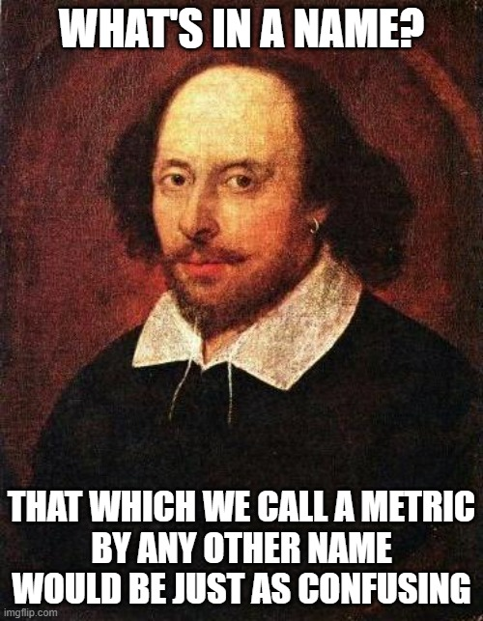
Telemetry Terminology
Logs
Metrics
Measurements. Think Prometheus/Grafana dashboards.
Traces
Spans. Think waterfall diagrams or Start/Stop events.
Timing is a grey area; prefer traces unless you need metric.
https://tinyurl.com/AzureMonitorOTELTerminology

Slide 7
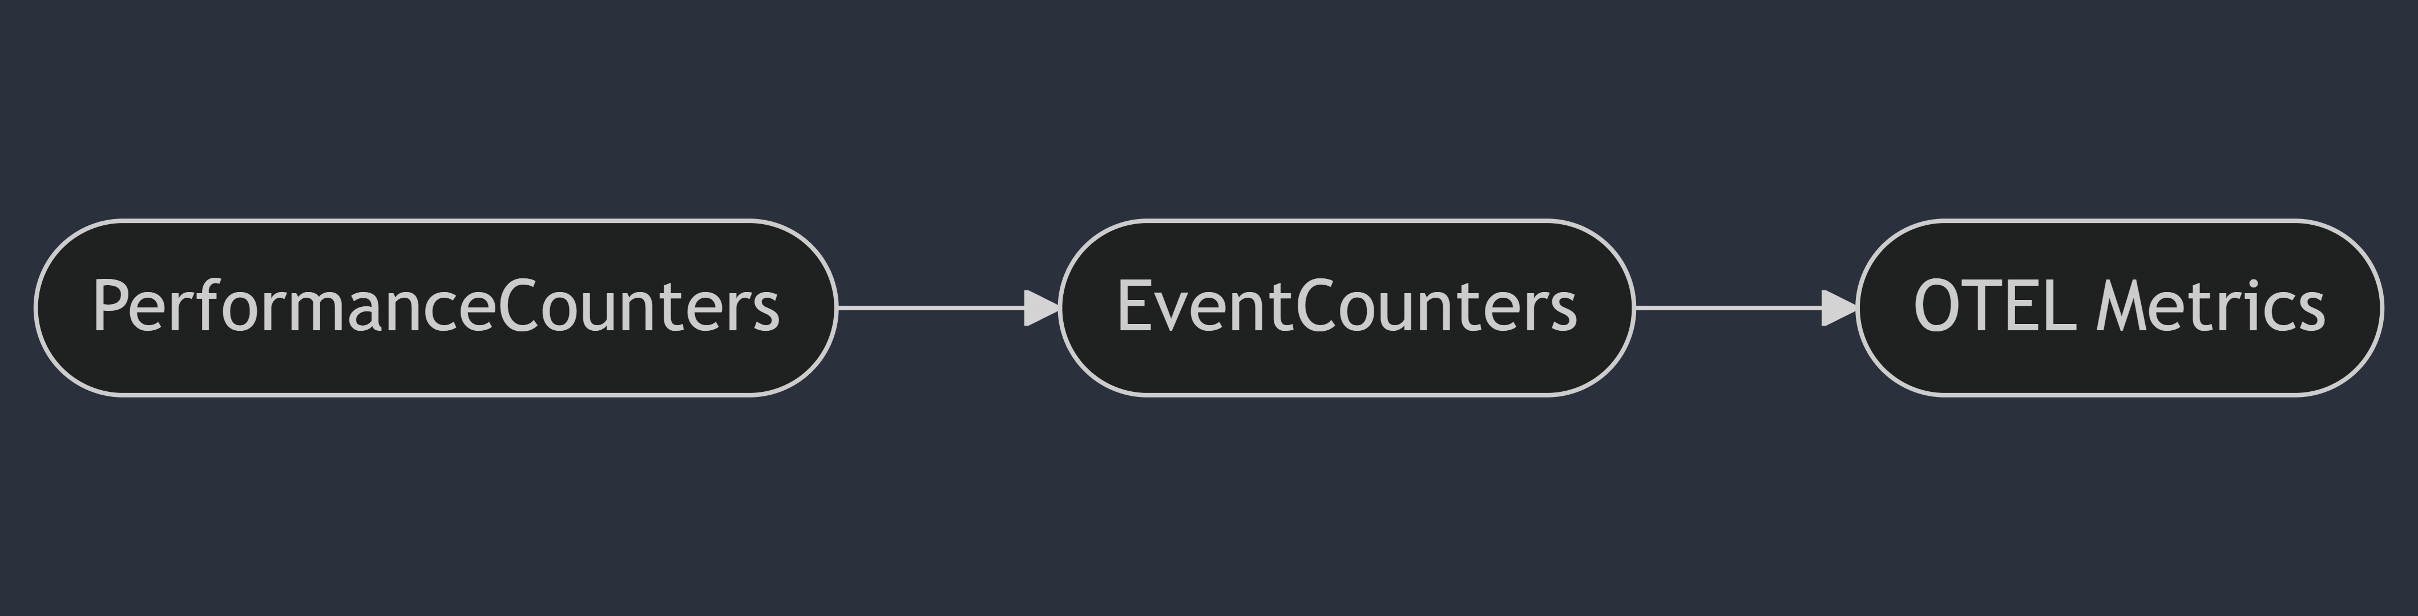
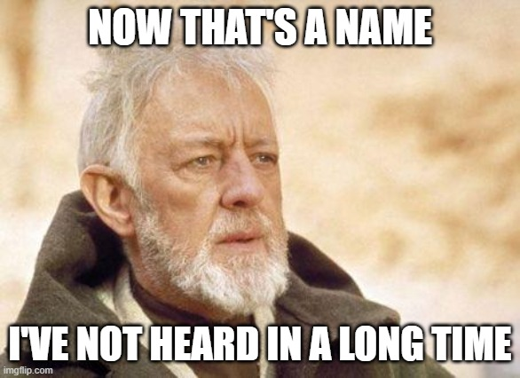
Telemetry History: Metrics

Slide 8

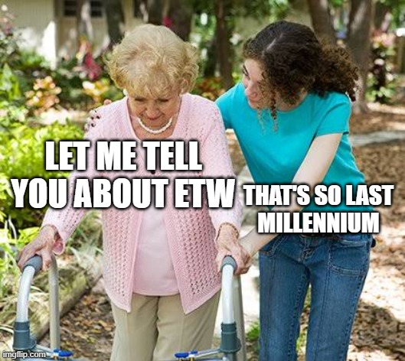
Telemetry History: Traces

Slide 9

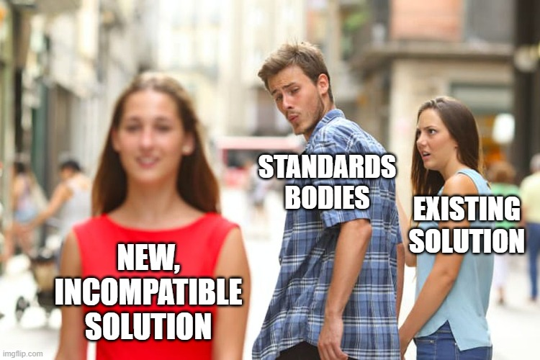
Telemetry History: Logs

Slide 10

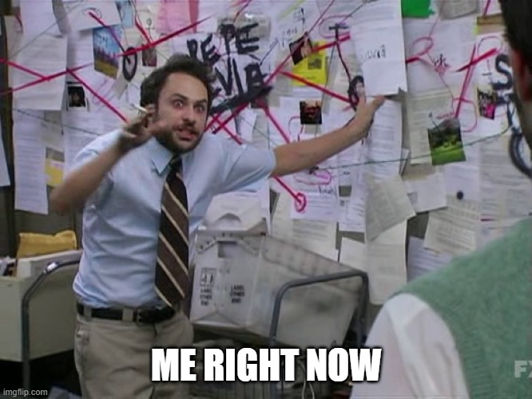
Demo: Local Telemetry
https://github.com/StephenCleary/LocalTelemetry

Slide 11
Demo: Telemetry the Easy Way
Notes:
(and under the covers)

Slide 12
Semantic Logging

Slide 13
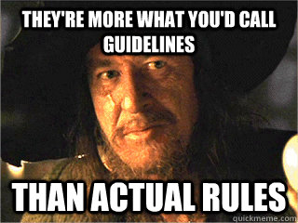
Semantic logging
A.k.a. Structured logging
A.k.a. Message templates https://messagetemplates.org/
Technically violates 12-factor app: https://12factor.net/

Slide 14
Semantic Logging: Getting a logger
Modern dependency injection
Configure your logger with its backend output(s).
Inject ILogger<T>
Note: if you need to dynamically create loggers, inject ILoggerFactory, not ILoggerProvider.
ILoggerFactory is for getting loggers for your components to use.
ILoggerProvider is for implementing custom backend outputs.
Tip: ILogger<T> is covariant; you can pass it to base types!
Everything else:
Configure a logger factory via LoggerFactory.Create
Call CreateLogger on the factory.

Slide 15
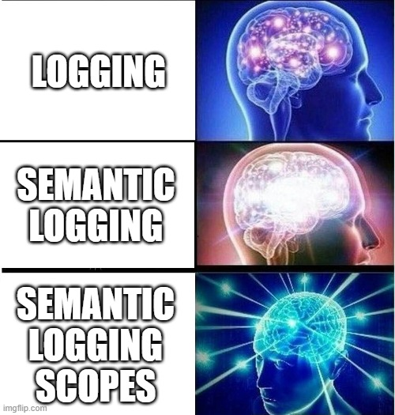
Semantic Logging: Basic Logging
Log with placeholders, like this:
_logger.LogInformation("Forecast result: {temperature}", temperature);
This is not string interpolation!
This is not format string arguments!
This is a message template.
What actually happens (mostly):
{ message: "Forecast result: 13", temperature: 13 }

Slide 16
Demo: Basic Semantic Logging
Notes:
And searching by tags
Do full Logos demo at this point.

Slide 17
Semantic Logging: Backend options
Cloud:
Azure AppInsights/Monitor https://tinyurl.com/WillAzureMonitorSupportOTLP
AWS CloudWatch (https://tinyurl.com/AWS-OTEL-logs)
(Use X-Ray for metrics: https://tinyurl.com/AWS-OTEL-metrics)
SaaS:
Graylog cloud
Papertrail
Self-hosted:
Graylog
Seq

Slide 18
Semantic Logging: Performance
Basic form:
_logger.LogInformation("Forecast result: {temperature}", temperature);
Performant form:
_logger.LogTemperature(temperature); [LoggerMessage(Level = LogLevel.Information, Message = "Forecast result: {temperature}")]
static partial void LogTemperature(this ILogger logger, int temperature);
Notes:
(I don’t bother; this is really for hot path or framework/library code)

Slide 19
Semantic Logging: Scopes!
This is your hero superpower.
Scopes allow you to attach name:value data pairs to all logs within a scope.
Notes:
I don’t want to add “User” to every single log statement!

Slide 20
Demo: Scopes

Slide 21
Semantic Logging Scopes
The scope type is IEnumerable<KeyValuePair<string, object>>
https://tinyurl.com/BeginScope
Tip: helpers are convenient. E.g., https://github.com/stephenCleary/Logging

Slide 22
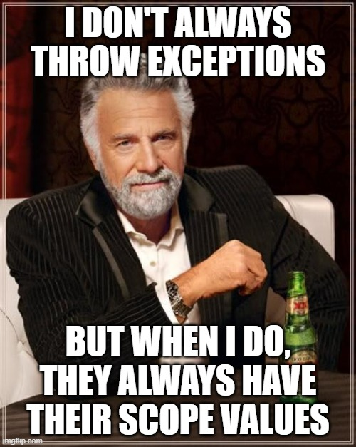
Semantic Logging Scopes
Common pitfall: exception handling scopes.
The scopes in force when the exception is thrown are different than when the exception is logged.
Workaround:
Capture the scopes when the exception is thrown.
Restore the scopes when the exception is logged.
https://github.com/stephenCleary/Logging
Alternative: Seq has a “throw context enricher”.
Notes:
“throw context enricher”: we wrote our own for log4net

Slide 23
Demo: Scopes in the Real World
Notes:
Including custom logger implementation.

Slide 24
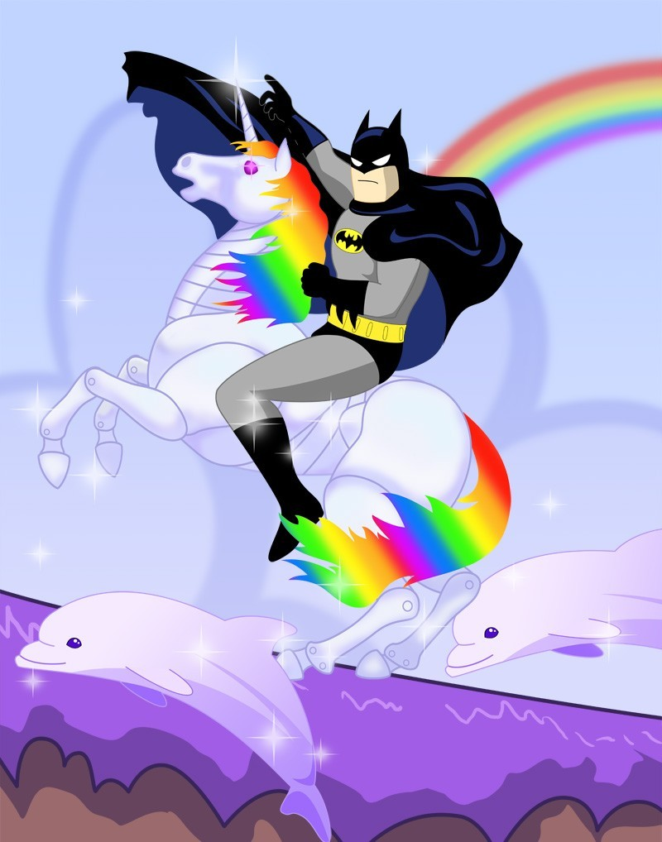
Q&A
Go forth and be awesome!
Image from Etsy user Rosewine; used with permission

Slide 25
Distributed tracing (including across queues):
https://tinyurl.com/OTEL-RabbitMQ
Pitfall:
Know your backend (e.g., Graylog’s ElasticSearch index typing)

